Slide 1
Sorting Techniques
Topic 1.3.1

Slide 2
Sort Approaches
In Place sort
A sorting algorithm is in-place if it requires only O(1) extra space to sort the array
Typically modifies the input collection
Useful to minimize memory usage
Stable sort
A sorting algorithm is stable if any equal items remain in the same relative order before and after the sort
Why do we care?
Sometimes we want to sort based on some, but not all attributes of an item
Items that “compareTo()” the same might not be exact duplicates
Enables us to sort on one attribute first then another etc…
[(8, “fox”), (9, “dog”), (4, “wolf”), (8, “cow”)]
[(4, “wolf”), (8, “fox”), (8, “cow”), (9, “dog”)]
Stable
[(4, “wolf”), (8, “cow”), (8, “fox”), (9, “dog”)]
Unstable

Slide 3
Divide and Conquer Technique
1. Divide your work into smaller pieces recursively
Pieces should be smaller versions of the larger problem
2. Conquer the individual pieces
Base case!
3. Combine the results back up recursively
divideAndConquer(input) {
if (small enough to solve)
conquer, solve, return results
else
divide input into a smaller pieces
recurse on smaller piece
combine results and return
}

Slide 4
Merge Sort
Divide
0 | 1 | 2 | 3 | 4 | 5 | 6 | 7 | 8 | 9
8 | 2 | 91 | 22 | 57 | 1 | 10 | 6 | 7 | 4
5 | 6 | 7 | 8 | 9
1 | 10 | 6 | 7 | 4
0 | 1 | 2 | 3 | 4
8 | 2 | 91 | 22 | 57
0
8
Conquer
0
8
Combine
0 | 1 | 2 | 3 | 4
2 | 8 | 22 | 57 | 91
5 | 6 | 7 | 8 | 9
1 | 4 | 6 | 7 | 10
0 | 1 | 2 | 3 | 4 | 5 | 6 | 7 | 8 | 9
1 | 2 | 4 | 6 | 7 | 8 | 10 | 22 | 57 | 91

Slide 5
Merge Sort
ALGORITHM
mergeSort(input) {
if (input.length == 1)
return
else
smallerHalf = mergeSort(new [0, ..., mid])
largerHalf = mergeSort(new [mid + 1, ...])
return merge(smallerHalf, largerHalf)
}
T(n) =
1 if n<= 1
2T(n/2) + n otherwise
= O(nlog(n))
Worst case runtime?
Best case runtime?
Average runtime?
Stable?
In-place?
Same as above
Same as above
Yes
No

Slide 6
Quick Sort
Divide
Conquer
Combine
0 | 1 | 2 | 3 | 4 | 5 | 6 | 7 | 8 | 9
8 | 2 | 91 | 22 | 57 | 1 | 10 | 6 | 7 | 4
0 | 1 | 2 | 3 | 4
2 | 1 | 6 | 7 | 4
0
8
0
6
0 | 1 | 2 | 3
91 | 22 | 57 | 10
0
6
5 | 6 | 7 | 8 | 9
1 | 4 | 6 | 7 | 10
0 | 2 | 3 | 4
2 | 22 | 57 | 91
0
8
0 | 1 | 2 | 3 | 4 | 5 | 6 | 7 | 8 | 9
1 | 2 | 4 | 6 | 7 | 8 | 10 | 22 | 57 | 91

Slide 7
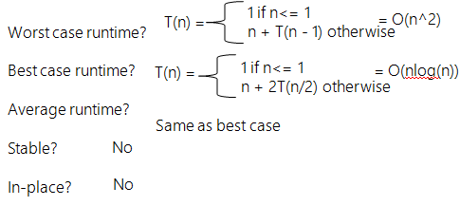
quickSort(input) {
if (input.length == 1)
return
else
pivot = getPivot(input)
smallerHalf = quickSort(getSmaller(pivot, input))
largerHalf = quickSort(getBigger(pivot, input))
return smallerHalf + pivot + largerHalf
}

Slide 8
Can we do better?
Pick a better pivot
Pick a random number
Pick the median of the first, middle and last element
Sort elements by swapping around pivot in place

Slide 9
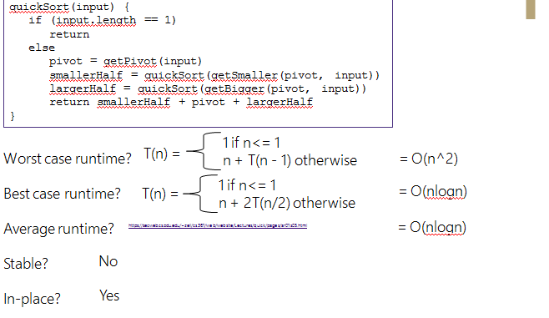
Algorithm

